Slide 1
How to build a brain from scratch
Lecture 2:
Unsupervised and generative models

Slide 2

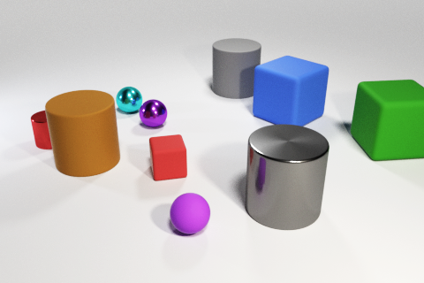
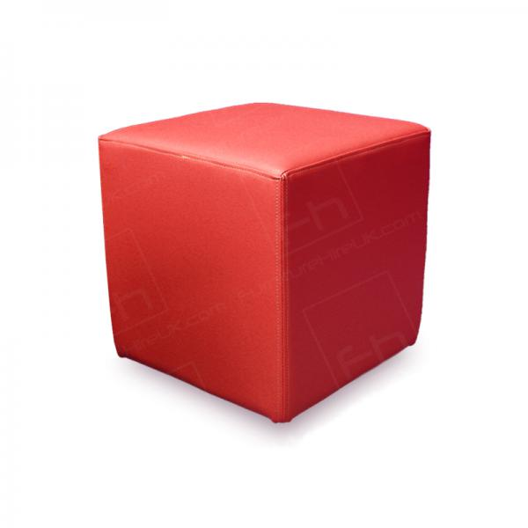
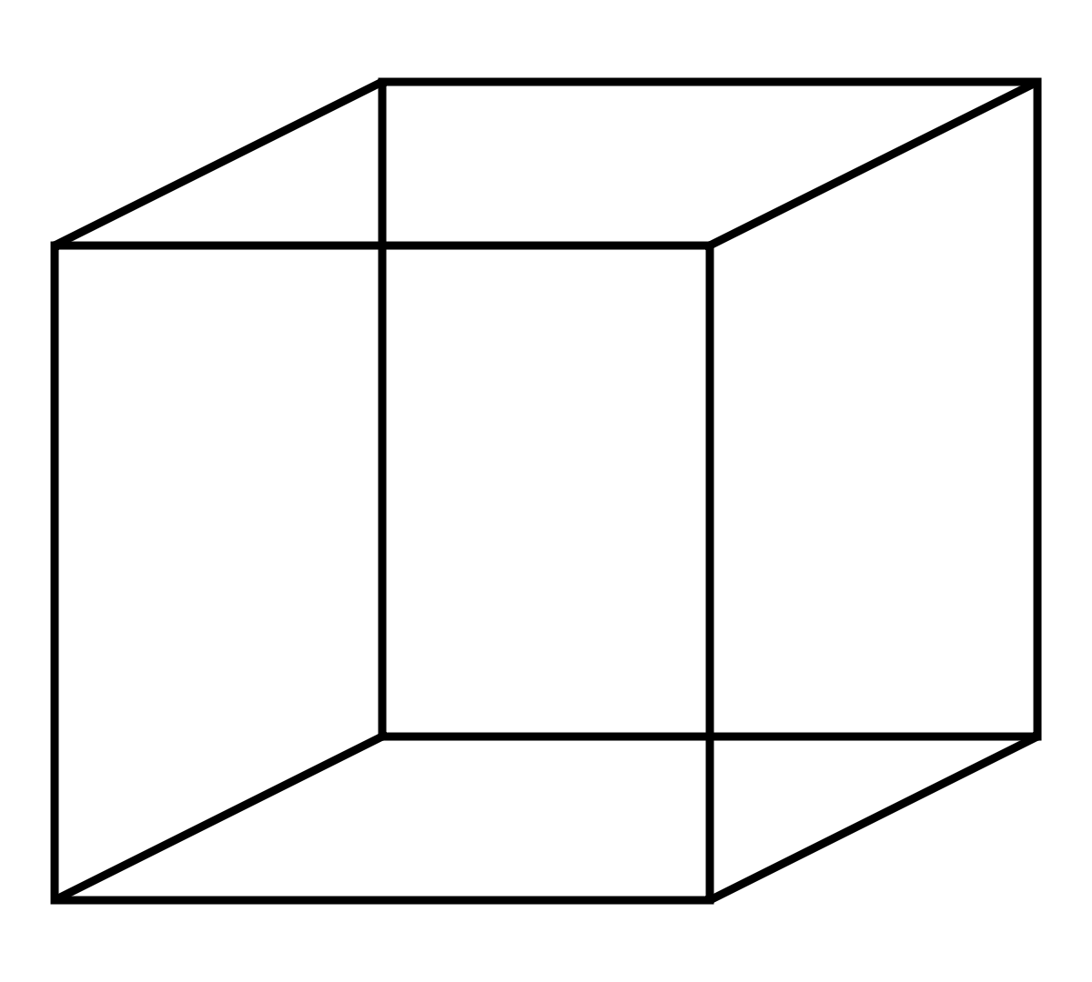

Object understanding
This is a thing
=
+
object
shape colour
Young infants understand that objects are distinct from the background, can be occluded or hidden, are solid, have immutable properties like shape and colour etc.
Object understanding is more than just assigning a category label. Infants must learn that an object is a “thing”
Notes:
Note that it’s not that the network lacks the capacity to learn both tasks.
It’s easy to find a network paramaterisation that meets the objectives of both tasks A and B.
It can be found by training the network on an interleaved fashion, in which tasks A and B are mixed together.
However, life isn’t like that for humans. We usually perform tasks in an autocorrelated fashion. For example, I might play the violin in the morning and the piano in the afternoon, but rarely switch rapidly between them during a concert.

Slide 3
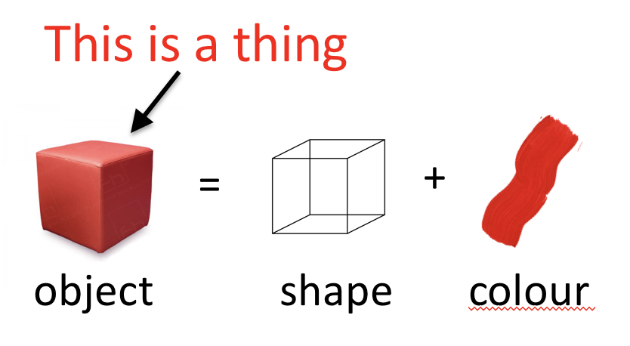
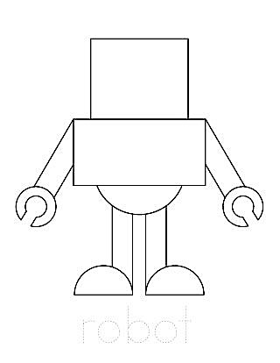
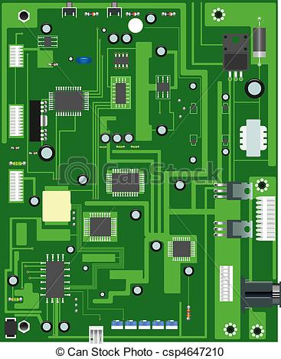

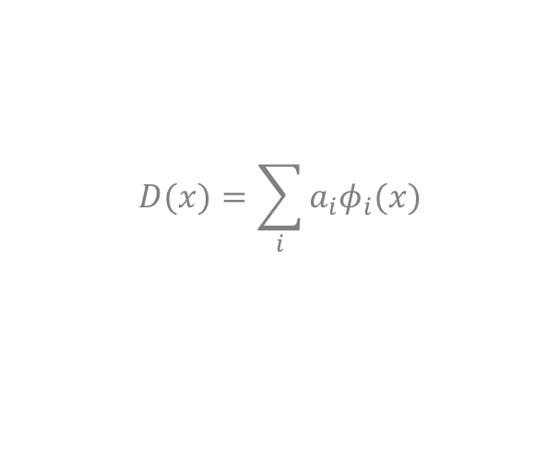
Unsupervised learning
unsupervised learning
Goal: to find a redescription of the input data that is both compact and useful for behaviour
sensory data
$$D(x)=\sum_{i}{a_{i}φ_{i}(x)}$$
world
data structure,
e.g. an image
parameters
components or basis functions
agent
In unsupervised learning, the agent encodes and organizes knowledge about the world purely by receiving sensory inputs
Notes:
Note that it’s not that the network lacks the capacity to learn both tasks.
It’s easy to find a network paramaterisation that meets the objectives of both tasks A and B.
It can be found by training the network on an interleaved fashion, in which tasks A and B are mixed together.
However, life isn’t like that for humans. We usually perform tasks in an autocorrelated fashion. For example, I might play the violin in the morning and the piano in the afternoon, but rarely switch rapidly between them during a concert.

Slide 4
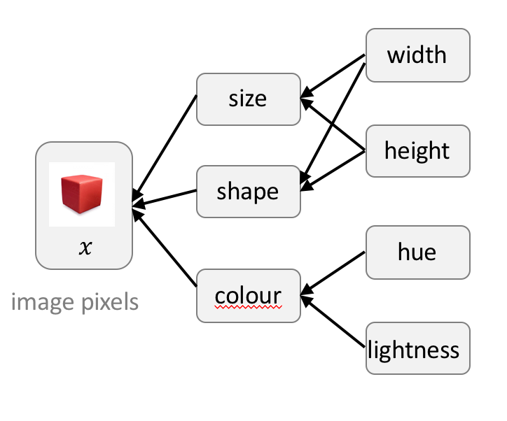
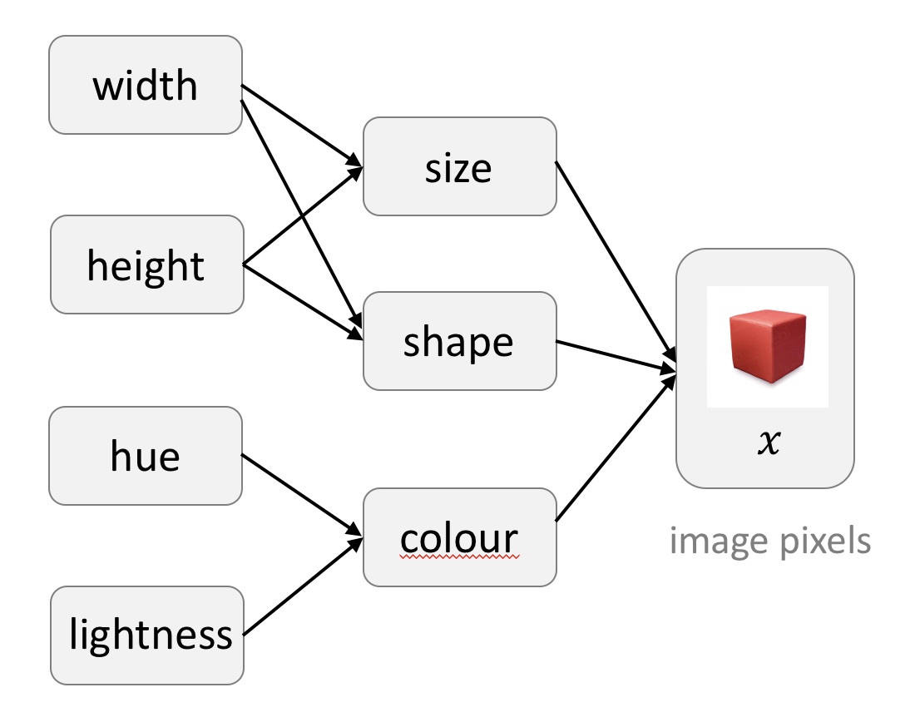

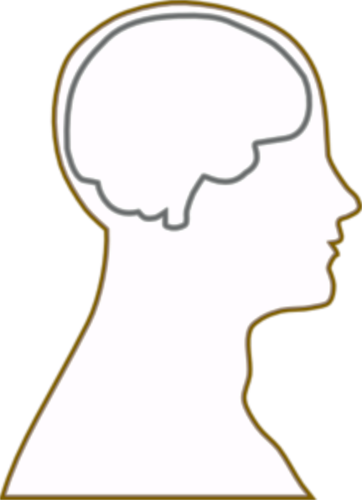
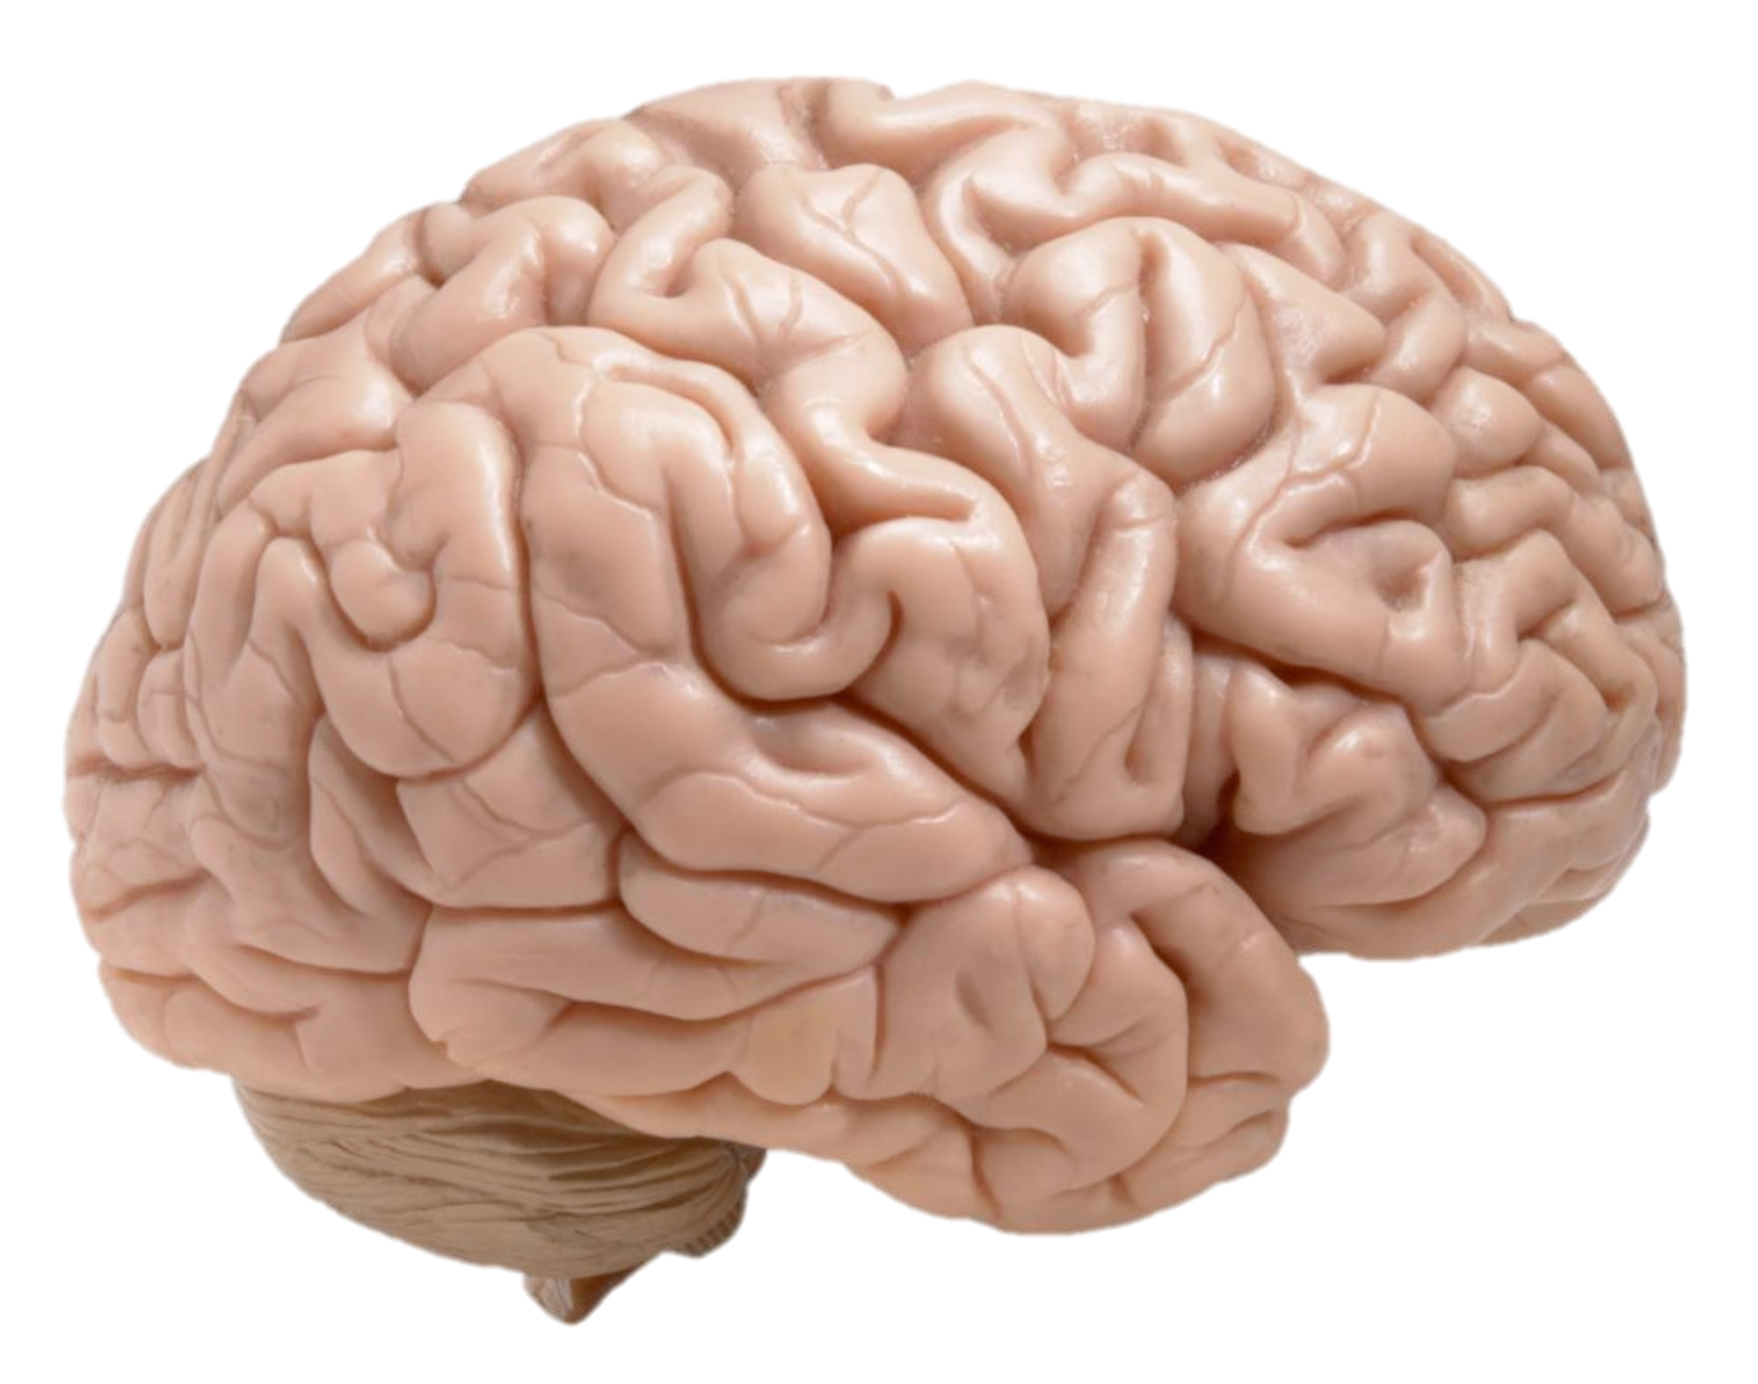
The hierarchical generative world
generative model
true factors of variation
latent factors
perception is an inference process by which we “invert” the generative model
One way of thinking about knowledge as encoding a model of the world, that is an inversion of the true data-generating process that gives rise to (noisy, ambiguous) sensory inputs
Notes:
Note that it’s not that the network lacks the capacity to learn both tasks.
It’s easy to find a network paramaterisation that meets the objectives of both tasks A and B.
It can be found by training the network on an interleaved fashion, in which tasks A and B are mixed together.
However, life isn’t like that for humans. We usually perform tasks in an autocorrelated fashion. For example, I might play the violin in the morning and the piano in the afternoon, but rarely switch rapidly between them during a concert.

Slide 5
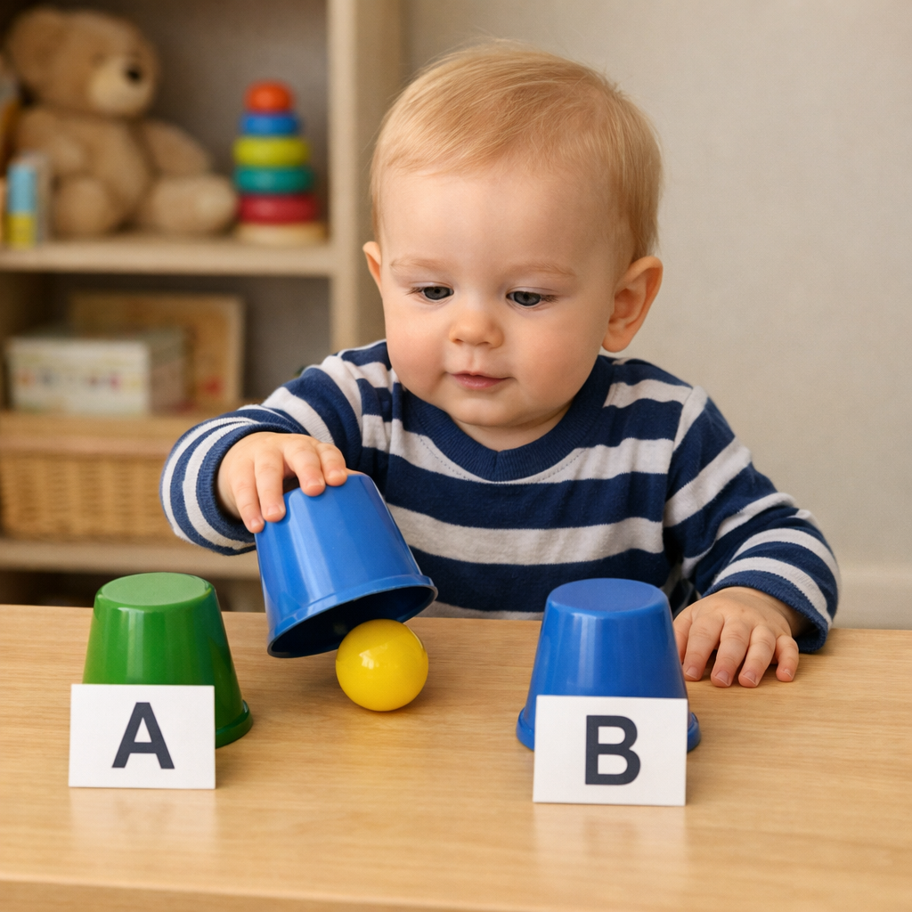
Poverty of feedback
The developmental literature demonstrates that infants learn about objects, words and people without direct supervision or reinforcement
One explanation is offered by nativist theories, which argue that this knowledge is inborn….
Notes:
Note that it’s not that the network lacks the capacity to learn both tasks.
It’s easy to find a network paramaterisation that meets the objectives of both tasks A and B.
It can be found by training the network on an interleaved fashion, in which tasks A and B are mixed together.
However, life isn’t like that for humans. We usually perform tasks in an autocorrelated fashion. For example, I might play the violin in the morning and the piano in the afternoon, but rarely switch rapidly between them during a concert.

Slide 6
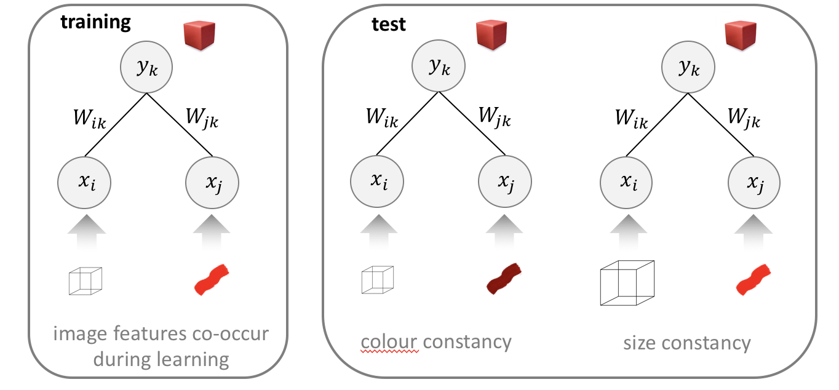
Hebbian learning
After training, the network is fault tolerant, i.e. the representations are invariant to small changes in the inputs
Hebbian learning allows patterns of correlation among inputs to be encoded, without an overt supervision signal
”I often see red and cube together, so a red cube is a thing”
Notes:
Note that it’s not that the network lacks the capacity to learn both tasks.
It’s easy to find a network paramaterisation that meets the objectives of both tasks A and B.
It can be found by training the network on an interleaved fashion, in which tasks A and B are mixed together.
However, life isn’t like that for humans. We usually perform tasks in an autocorrelated fashion. For example, I might play the violin in the morning and the piano in the afternoon, but rarely switch rapidly between them during a concert.

Slide 7
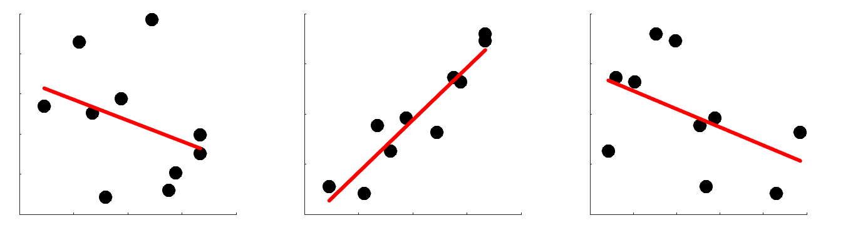
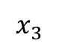
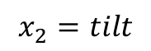
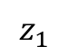
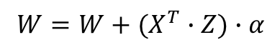
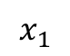
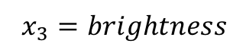
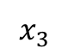
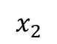
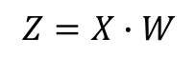
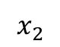
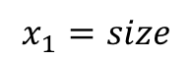
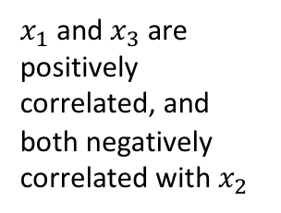
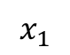
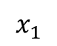
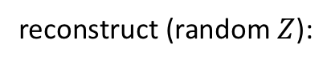
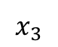
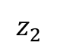
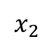
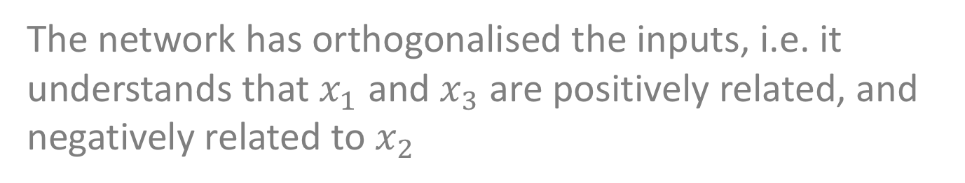
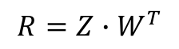
Example PCA implementation
e.g. “big things are bright”
$$x_{1}$$
*
train:
$$z_{1}$$
$$Z=X∙W$$
$$x_{3}$$
$$x_{2}$$
$$W=W+(X^{T}∙Z)∙α$$
$$x_{2}$$
$$z_{2}$$
reconstruct (random $Z$):
$$x_{3}$$
$$x_{1}$$
$$x_{1}$$
$$R=Z∙W^{T}$$
$$x_{1}=size$$
>> corr(R)
ans =
1 -1 1
-1 1 -1
1 -1 1
$$x_{3}$$
$x_{1}$ and${ x}_{3}$ are positively correlated, and both negatively correlated with $x_{2}$
$$x_{2}=tilt$$
$$x_{3}=brightness$$
$$x_{2}$$
The network has orthogonalised the inputs, i.e. it understands that $x_{1}$ and $x_{3}$ are positively related, and negatively related to $x_{2}$
*actually for this example only a single $z$ unit is needed
Notes:
Note that it’s not that the network lacks the capacity to learn both tasks.
It’s easy to find a network paramaterisation that meets the objectives of both tasks A and B.
It can be found by training the network on an interleaved fashion, in which tasks A and B are mixed together.
However, life isn’t like that for humans. We usually perform tasks in an autocorrelated fashion. For example, I might play the violin in the morning and the piano in the afternoon, but rarely switch rapidly between them during a concert.

Slide 8
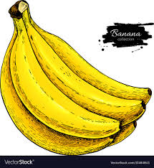
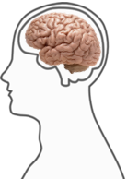
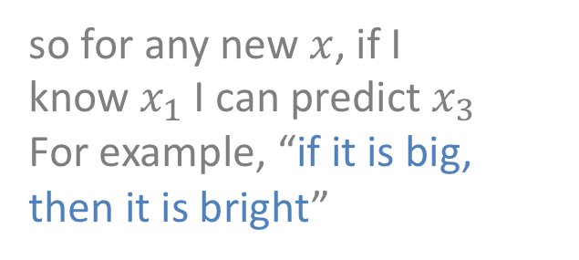
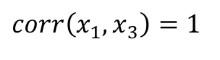
Evaluating unsupervised learning
How do we know if our unsupervised network is any good? It isn’t predicting some ground truth, or harvesting reward, so we don’t have an evaluation metric!
One way of thinking about an unsupervised network is as a predictive model
recall that
$corr\left(x_{1},x_{3}\right)=1$
so for any new $x$, if I know${ x}_{1}$ I can predict $x_{3}$
For example, “if it is big, then it is bright”
Notes:
Note that it’s not that the network lacks the capacity to learn both tasks.
It’s easy to find a network paramaterisation that meets the objectives of both tasks A and B.
It can be found by training the network on an interleaved fashion, in which tasks A and B are mixed together.
However, life isn’t like that for humans. We usually perform tasks in an autocorrelated fashion. For example, I might play the violin in the morning and the piano in the afternoon, but rarely switch rapidly between them during a concert.

Slide 9

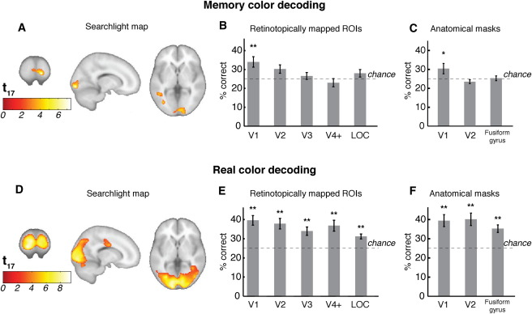
The predictive brain
The brain is constantly making predictions in a way described by unsupervised, but not supervised models
decode “yellow”
decode “yellow”
Predicted colour can be decoded from visual cortex BOLD signals using fMRI, even in the absence of instruction to imagine
Bannert & Bartels 2013
Notes:
Note that it’s not that the network lacks the capacity to learn both tasks.
It’s easy to find a network paramaterisation that meets the objectives of both tasks A and B.
It can be found by training the network on an interleaved fashion, in which tasks A and B are mixed together.
However, life isn’t like that for humans. We usually perform tasks in an autocorrelated fashion. For example, I might play the violin in the morning and the piano in the afternoon, but rarely switch rapidly between them during a concert.

Slide 10
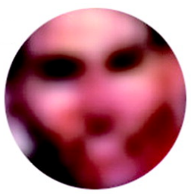
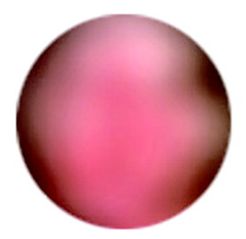
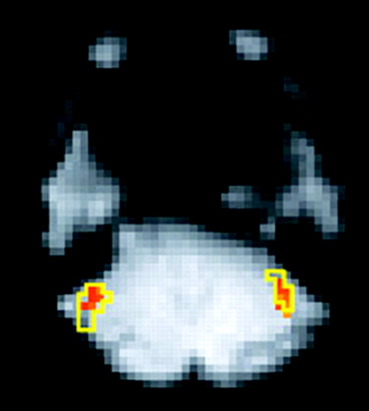
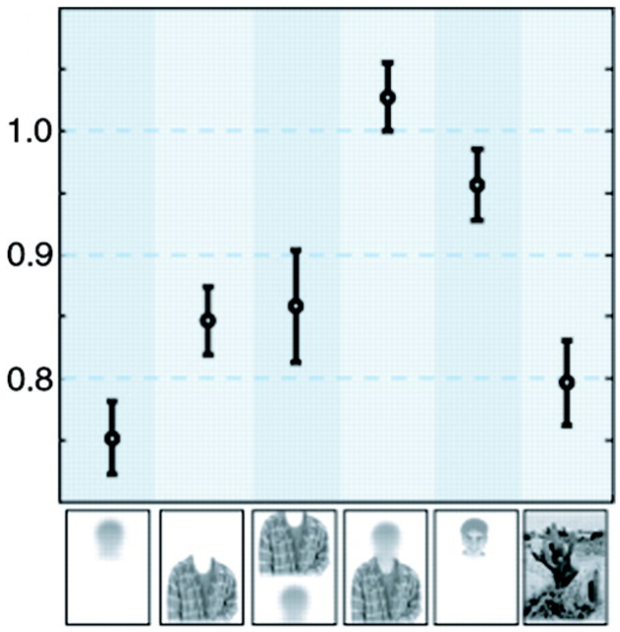
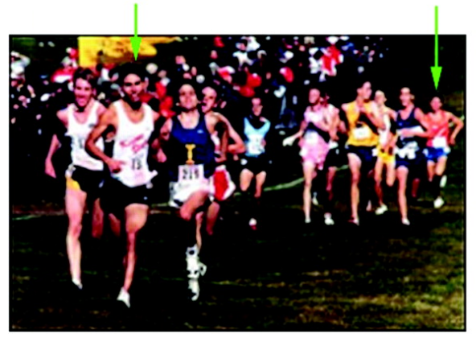
Top-down perception
FFA
FFA BOLD responds more strongly to the suggestion of a face than to the actual presentation of a face
Cox et al 2004
Notes:
Note that it’s not that the network lacks the capacity to learn both tasks.
It’s easy to find a network paramaterisation that meets the objectives of both tasks A and B.
It can be found by training the network on an interleaved fashion, in which tasks A and B are mixed together.
However, life isn’t like that for humans. We usually perform tasks in an autocorrelated fashion. For example, I might play the violin in the morning and the piano in the afternoon, but rarely switch rapidly between them during a concert.

Slide 11
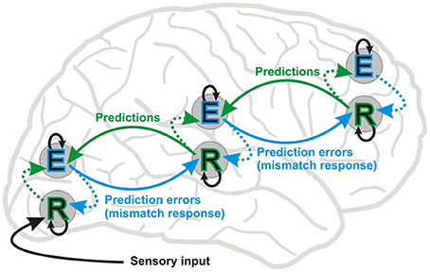

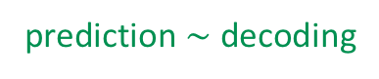
Predictive coding
Predictive coding is a computational framework proposing that encoding and decoding occur repeatedly at successive hierarchical levels of the cortex
Priors at each level are combined with sensory signals at the level below, via re-entrant (feedback) connectivity
Error signal are computed as the mismatch between predictions and error signals, and are sent forward to adjust future predictions
prediction $\sim$ decoding
prediction errors $\sim$ encoding (of residuals)
Predictive coding proposes that perceptual inference occurs via multiple iterative cycles of encoding and decoding
Bastos 2012; Friston 2005
Notes:
Note that it’s not that the network lacks the capacity to learn both tasks.
It’s easy to find a network paramaterisation that meets the objectives of both tasks A and B.
It can be found by training the network on an interleaved fashion, in which tasks A and B are mixed together.
However, life isn’t like that for humans. We usually perform tasks in an autocorrelated fashion. For example, I might play the violin in the morning and the piano in the afternoon, but rarely switch rapidly between them during a concert.

Slide 12
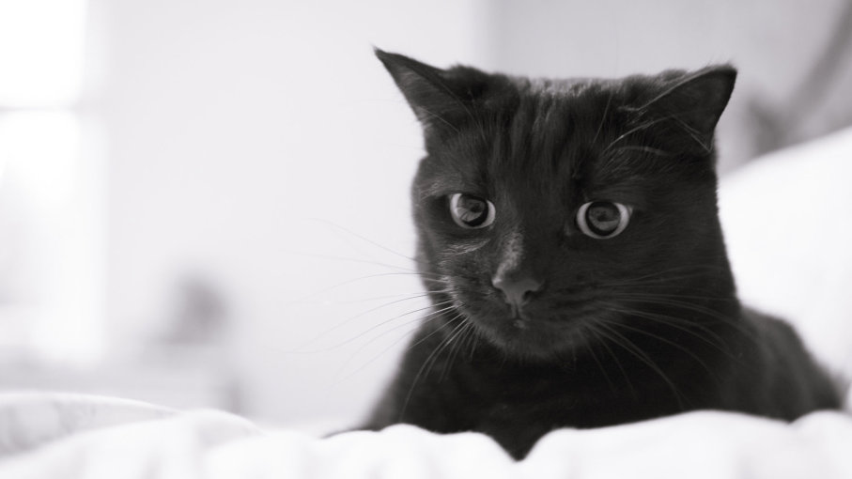

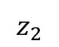
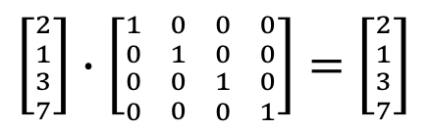
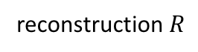











Autoencoder
encoder
decoder
input $X$
reconstruction $R$
$$x_{1}$$
$$r_{1}$$
$$W$$
$$z_{1}$$
$$x_{2}$$
$$r_{2}$$
Optimise $W$ to minimize reconstruction error
But hold on… $X∙I=X!$
$$z_{2}$$
$$x_{3}$$
$$r_{3}$$
latent
representation
$\left[{{2 \atop 1} \atop {3 \atop 7}}\right]∙\left[{{1 \atop 0} \atop {0 \atop 0}} {{0 \atop 1} \atop {0 \atop 0}} {{0 \atop 0} \atop {1 \atop 0}} {{0 \atop 0} \atop {0 \atop 1}}\right]=$ $\left[{{2 \atop 1} \atop {3 \atop 7}}\right]$
So why doesn’t the network just learn the identity matrix?
compare input and reconstruction
For the network to compress the image, $n\left(Z\right)<n(X)$ i.e. the latent layer must be a “bottleneck”
$$loss=\sum_{x,y}{{\left[I\left(x,y\right)−\sum_{i}{a_{i}φ_{i}(x,y)}\right]}^{2}}$$
Notes:
Note that it’s not that the network lacks the capacity to learn both tasks.
It’s easy to find a network paramaterisation that meets the objectives of both tasks A and B.
It can be found by training the network on an interleaved fashion, in which tasks A and B are mixed together.
However, life isn’t like that for humans. We usually perform tasks in an autocorrelated fashion. For example, I might play the violin in the morning and the piano in the afternoon, but rarely switch rapidly between them during a concert.

Slide 13










Autoencoder
train
encoder
decoder
reconstruct
$$x_{1}$$
$$r_{1}$$
$$z_{1}$$
$$x_{2}$$
$$r_{2}$$
$$z_{2}$$
$$x_{3}$$
$$r_{3}$$
latent
representation
”cat concept”
new cats the network has never seen!
The goal is to build an generative network that can “imagine” realistic images, text, music… just like humans can write new poems and compose new novels…
Notes:
Note that it’s not that the network lacks the capacity to learn both tasks.
It’s easy to find a network paramaterisation that meets the objectives of both tasks A and B.
It can be found by training the network on an interleaved fashion, in which tasks A and B are mixed together.
However, life isn’t like that for humans. We usually perform tasks in an autocorrelated fashion. For example, I might play the violin in the morning and the piano in the afternoon, but rarely switch rapidly between them during a concert.

Slide 14



Sparse coding model
OK. so why not just do PCA on image pixels?
filters from PCA model
You could. But you don’t learn a set of biologically plausible filters (basis functions), and the reconstructions don’t resemble real images
PCA captures the structure of data in which linear pairwise correlations are the most important form of statistical dependence
$$I(x,y)=\sum_{i}{a_{i}φ_{i}(x,y)}$$
x and y here denote image axes, not network inputs/outputs
Olhausen & Field 1996
Notes:
Note that it’s not that the network lacks the capacity to learn both tasks.
It’s easy to find a network paramaterisation that meets the objectives of both tasks A and B.
It can be found by training the network on an interleaved fashion, in which tasks A and B are mixed together.
However, life isn’t like that for humans. We usually perform tasks in an autocorrelated fashion. For example, I might play the violin in the morning and the piano in the afternoon, but rarely switch rapidly between them during a concert.

Slide 15


Sparse coding model
However, a sparsity assumption helps
$$loss=\sum_{x,y}{{\left[I\left(x,y\right)−\sum_{i}{a_{i}φ_{i}(x,y)}\right]}^{2}+log\left[1+{\left(\frac{a_{i}}{σ}\right)}^{2}\right]}$$
The sparsity cost ensures that optimization finds the solution with the smallest number of nonzero coefficients (weights)
reconstruction error
sparsity cost
filters from sparse coding model
This allows biologically plausible basis functions to be learned
i.e. orientation and spatial frequency selective receptive fields such as those observed in V1
However, reconstruction is still poor
Olhausen & Field 1996
Notes:
Note that it’s not that the network lacks the capacity to learn both tasks.
It’s easy to find a network paramaterisation that meets the objectives of both tasks A and B.
It can be found by training the network on an interleaved fashion, in which tasks A and B are mixed together.
However, life isn’t like that for humans. We usually perform tasks in an autocorrelated fashion. For example, I might play the violin in the morning and the piano in the afternoon, but rarely switch rapidly between them during a concert.

Slide 16










Variational autoencoder
reconstruction
2D embedding of MNIST digits. Activity states Z between the clusters will generate nonsense
$$R=\tilde{X}$$
decoder
$$p_{φ}(x|z)$$
$$Z$$
latent
$$z_{2}$$
encoder
$$q_{θ}(z|x)$$
$$X$$
$$z_{1}$$
What is needed is nicely clustered latent states….i.e. a smooth conceptual space
MNIST character dataset
Notes:
Note that it’s not that the network lacks the capacity to learn both tasks.
It’s easy to find a network paramaterisation that meets the objectives of both tasks A and B.
It can be found by training the network on an interleaved fashion, in which tasks A and B are mixed together.
However, life isn’t like that for humans. We usually perform tasks in an autocorrelated fashion. For example, I might play the violin in the morning and the piano in the afternoon, but rarely switch rapidly between them during a concert.

Slide 17














Variational autoencoder
reconstruction
Now there’s a much better latent representation. Note that 7 (purple) lies nearly between 1 and 2
$$R=\tilde{X}$$
$$decoder$$
sampling
$$μ_{i}$$
$$μ_{k}$$
$$σ_{i}$$
$$σ_{k}$$
$$z_{2}$$
$$μ$$
$$σ$$
$$encoder$$
$$z_{1}$$
The VAE uses an additional cost term that tries to keep the parameters $μ\sim 0$ and $σ\sim 1$ i.e. keep the sampling distributions standard normal
$$X$$
Notes:
Note that it’s not that the network lacks the capacity to learn both tasks.
It’s easy to find a network paramaterisation that meets the objectives of both tasks A and B.
It can be found by training the network on an interleaved fashion, in which tasks A and B are mixed together.
However, life isn’t like that for humans. We usually perform tasks in an autocorrelated fashion. For example, I might play the violin in the morning and the piano in the afternoon, but rarely switch rapidly between them during a concert.

Slide 18





Beta-VAE
left
$$Z$$
right
smiley
$$Z$$
frowny
baldy
$$Z$$
fringy
The $β$-VAE simply places a stronger constraint on the latent bottleneck relative to reconstruction error
One could argue that this network has learned visual “concepts” pertaining to faces and other objects
Higgins et al 2017
Notes:
Note that it’s not that the network lacks the capacity to learn both tasks.
It’s easy to find a network paramaterisation that meets the objectives of both tasks A and B.
It can be found by training the network on an interleaved fashion, in which tasks A and B are mixed together.
However, life isn’t like that for humans. We usually perform tasks in an autocorrelated fashion. For example, I might play the violin in the morning and the piano in the afternoon, but rarely switch rapidly between them during a concert.

Slide 19

Generative Adversarial Networks
This person does not exist! AI-generated photos now indistinguishable from real photos
Notes:
Note that it’s not that the network lacks the capacity to learn both tasks.
It’s easy to find a network paramaterisation that meets the objectives of both tasks A and B.
It can be found by training the network on an interleaved fashion, in which tasks A and B are mixed together.
However, life isn’t like that for humans. We usually perform tasks in an autocorrelated fashion. For example, I might play the violin in the morning and the piano in the afternoon, but rarely switch rapidly between them during a concert.

Slide 20



Language modelling
Micha Heilbron
Wikipedia
ChatGPT
language is a generative problem…
(c.f. Chomsky’s ”generative grammar”)

Slide 21

Language modelling
context
Ada Lovelace was an English _________
model
(neural network)
breakfast
mathematician
rose
table
token
probabilities (perplexity)

Slide 22






The transformer
$$Q=f(X,θ_{Q})$$
$K^{T}$ encodes the self-similarity of each index in $K$
$$K=f(X,θ_{K})$$
$$V=f(X,θ_{V})$$

Slide 23

The transformer
Lines and shading show strength of self-attention to last word in sequence
Note gender stereotyping!! Neural networks learn biases from training data
Transformers learn to ”attend” to relevant parts of the context to make a prediction about the next token

Slide 24

In-context learning
Models are now extremely good

